Slide 1

DESIGN AND ANALYSIS OF ALGORITHMS
Dr. Kashif Ayyub

Slide 2
Binary Search Method
BINARY-SEARCH (A, lo, hi, x)
if (lo > hi)
return FALSE
mid ← ⎣(lo+hi)/2⎦
if x = A[mid]
return TRUE
if ( x < A[mid] )
BINARY-SEARCH (A, lo, mid-1, x)
if ( x > A[mid] )
BINARY-SEARCH (A, mid+1, hi, x)
constant time: c₁
constant time: c₂
constant time: c₃
same problem of size n/2
same problem of size n/2

Slide 3
Binary Search Example
target is 33
The array a looks like this:
Indices
Contents
0 1 2 3 4 5 6 7 8 9
5 7 9 13 32 33 42 54 56 88
mid = (0 + 9) / 2 (which is 4)
33 > a[mid] (that is, 33 > a[4])
So, if 33 is in the array, then 33 is one of:
5 6 7 8 9
33 42 54 56 88
Eliminated half of the remaining elements from consideration because array elements are sorted.

Slide 4
Binary Search Example
target is 33
The array a looks like this:
Indexes
Contents
0 1 2 3 4 5 6 7 8 9
5 7 9 13 32 33 42 54 56 88
mid = (5 + 9) / 2 (which is 7)
33 < a[mid] (that is, 33 < a[7])
So, if 33 is in the array, then 33 is one of:
Eliminate half of the remaining elements
5 6
33 42
mid = (5 + 6) / 2 (which is 5)
33 == a[mid]
So we found 33 at index 5:
5
33

Slide 5
Worst-case Analysis
Item not in the array (size N)
T(N) = number of comparisons with array elements
T(1) = 1
T(N) = 1 + T(N / 2)

Slide 6
Worst-case Analysis
Item not in the array (size N)
T(N) = number of comparisons with array elements
T(1) = 1
T(N) = 1 + T(N / 2)
= 1 + [1 + T(N / 4)]

Slide 7
Worst-case Analysis
Item not in the array (size N)
T(N) = number of comparisons with array elements
T(1) = 1
T(N) = 1 + T(N / 2)
= 1 + [1 + T(N / 4)]
= 2 + T(N / 4)
= 2 + [1 + T(N / 8)]

Slide 8
Worst-case Analysis
Item not in the array (size N)
T(N) = number of comparisons with array elements
T(1) = 1
T(N) = 1 + T(N / 2) ←
= 1 + [1 + T(N / 4)]
= 2 + T(N / 4) ←
= 2 + [1 + T(N / 8)]
= 3 + T(N / 8) ←
= …

Slide 9
Worst-case Analysis
Item not in the array (size N)
T(N) = number of comparisons with array elements
T(1) = 1
T(N) = 1 + T(N / 2) ←
= 1 + [1 + T(N / 4)]
= 2 + T(N / 4) ←
= 2 + [1 + T(N / 8)]
= 3 + T(N / 8) ←
= …
= k + T(N / 2^{k} ) [1]

Slide 10
Worst-case Analysis
T(N) = k + T(N / 2^{k} ) [1]
T(N / 2^{k} ) gets smaller until the base case: T(1)
2^{k} = N
k = log₂N
Replace terms with k in [1]:
T(N) = log₂N + T(N / N)
= log₂N + T(1)
= log₂N + 1
“log₂N” algorithm
We used recurrence equations

Slide 11
Recurrence
A recurrence is an equation or inequality that describes a function in terms of itself by using smaller inputs.
Recurrences arise when an algorithm contains recursive calls to itself.
What is the actual running time of the algorithm?
Need to solve the recurrence
Find an explicit formula of the expression
Bound the recurrence by an expression that involves n
The expression is a recurrence

Slide 12
Example
Function(int number)
if n<=1
then return;
else
Function(number/2)
Function(number/2)
for(i=1 to number )
Display i;
It follows that
T(n) = 2 T(n/2)+ cn
work done dividing and combining
number of sub-problems
Sub-problem size

Slide 13
Recursion Tree for Algorithm
cn
T(n/2)
T(n/2)

Slide 14
Recursion Tree for Algorithm
cn
cn/2
cn/2
T(n/4)
T(n/4)
T(n/4)
T(n/4)

Slide 15
Recursion Tree for Algorithm
cn
cn/2
cn/2
T(n/4)
T(n/4)
T(n/4)
T(n/4)
Eventually, the input size (the argument of T) goes to 1, so...

Slide 16
Recursion Tree for Algorithm
cn
cn/2
cn/2
T(n/4)
T(n/4)
T(n/4)
T(n/4)
T(1)
T(1)
T(1)
T(1)
.............................
T(1)
T(1)
n sub problems of size 1, but T(1) = c by boundary condition

Slide 17
Recursion Tree for Algorithm
cn
cn/2
cn/2
T(n/4)
T(n/4)
T(n/4)
T(n/4)
c
c
c
c
.............................
c
c
n subproblems of size 1

Slide 18
Recursion Tree for Algorithm
level nodes/ cost/
level level
0 2⁰ = 1 cn
1 2¹ = 2 cn
2 2² = 4 cn
. .
. .
. .
N-1 2^{N-1}=n cn
Since 2^{N-1} = n, lg(2^{N-1}) = lg(n)
levels = N = 1+lg(n)
T(n) = total cost = (levels)(cost/level)
T(n) = cn [1+lg(n)] = O( n lg(n))
n nodes at level N-1

Slide 19
Methods for Solving Recurrence Relations
No universal method exists that would enable us to solve every recurrence relation.
Following are some that can solve a variety of recurrences.
Iteration method
Master method

Slide 20
The Iteration Method
Expand the recurrence k times
Work some algebra to express as a summation
Evaluate the summation

Slide 21
Example - 1
T(n) = c + T(n-1) = c + c + T(n-2)
= 2c + T(n-2) = 2c + c + T(n-3)
= 3c + T(n-3) … kc + T(n-k)
= ck + T(n-k)
So far for n ≥ k we have
T(n) = ck + T(n-k)
To stop the recursion, we should have
n - k = 0 ➔ k = n
T(n) = cn + T(0) = cn
Thus in general T(n) = O(n)

Slide 22
Example - 2
T(n) = n + T(n-1)
= n + n-1 + T(n-2)
= n + n-1 + n-2 + T(n-3)
= n + n-1 + n-2 + n-3 + T(n-4)
= …
= n + n-1 + n-2 + n-3 + … + (n-k+1) + T(n-k)
To stop the recursion, we should have n - k = 0 ➔ k = n
Algo A(int n)
{
if (n>0)
{
for(i=0;i<n;i++)
printf("%d",n);
}
A(n-1);
}

Slide 23
Example - 3
T(n) = 2 T(n/2) + c 1
= 2(2 T(n/2/2) + c) + c 2
= 2² T(n/2²) + 2c + c
= 2²(2 T(n/2²/2) + c) + (2²-1)c 3
= 2³ T(n/2³) + 4c + 3c
= 2³ T(n/2³) + (2³-1)c
= 2³(2 T(n/2³/2) + c) + 7c 4
= 2⁴ T(n/2⁴) + (2⁴-1)c
= …
= 2^{k} T(n/2^{k}) + (2^{k} - 1)c k

Slide 24
Example - 3
So far for n ≥ k we have
T(n) = 2^{k} T(n/2^{k}) + (2^{k} - 1)c
To stop the recursion, we should have
n/2^{k} = 1 ➔ k = lg n
T(n) = 2^{lgn} T(n/2^{lgn}) + (2^{lgn} - 1)c
= n T(n/n) + (n - 1)c
= n T(1) + (n-1)c
= nc + (n-1)c
= nc + nc – c = 2cn – c = cn – c/2
≤ cn = Ο(n) for all n ≥ ½

Slide 25



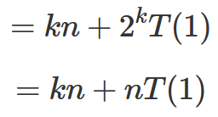


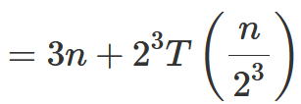

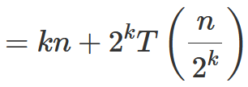

Example - 4

Slide 26
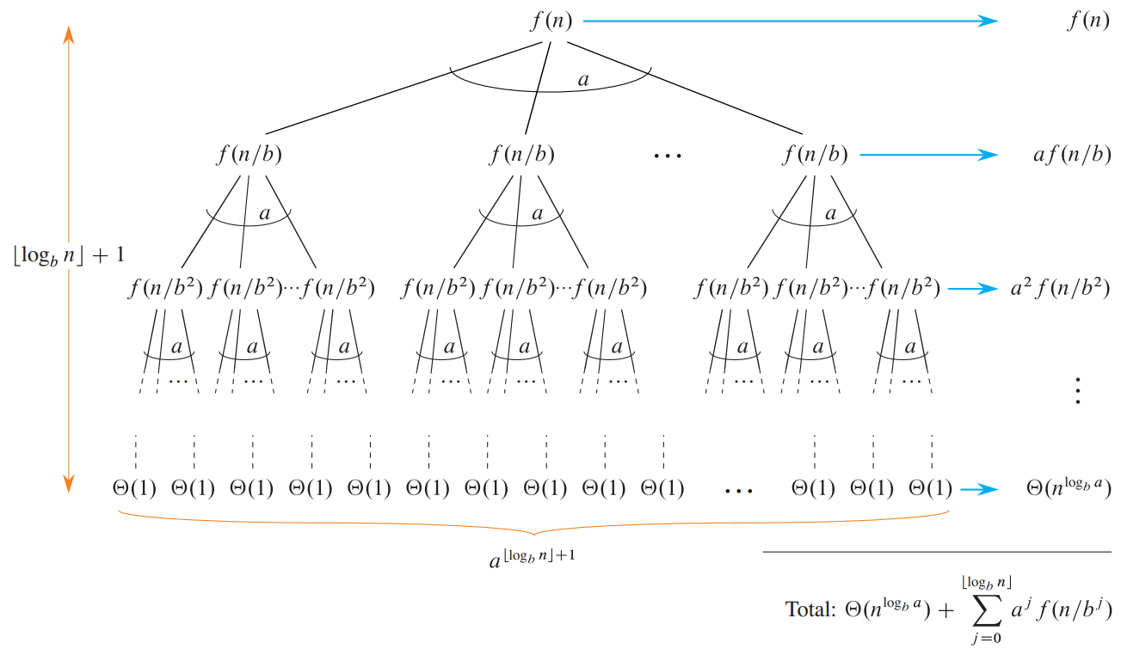
The Master Theorem

Slide 27
The Master Theorem
Given: a divide and conquer algorithm
An algorithm that divides the problem of size n into a subproblems, each of size n/b
Let the cost of each stage (i.e., the work to divide the problem + combine solved subproblems) be described by the function f(n)
Then, the Master Theorem gives us a cookbook for the algorithm’s running time:

Slide 28
The Master Theorem
if T(n) = aT(n/b) + f(n) where a ≥ 1 & b > 1
then

Slide 29
Using The Master Method: Case 1
T(n) = 9T(n/3) + n
a = 9, b = 3, f(n) = n
n^{logb a} = n^{log39} = n²
since f(n) = O(n^{log39 - ε}) = O(n^{2-0.5}) = O(n^{1.5})
where ε = 0.5
case 1 applies:
Thus the solution is
T(n) = Θ(n²)

Slide 30
Using The Master Method: Case 2
T(n) = T(2n/3) + 1
a = 1, b = 3/2, f(n) = 1
n^{logba} = n^{log3/21} = n⁰ = 1
since f(n) = Θ(n^{logba}) = Θ(1)
case 2 applies:
Thus the solution is
T(n) = Θ(lg n)

Slide 31
Using The Master Method: Case 3
T(n) = 3T(n/4) + n lg n
a = 3, b = 4, f(n) = n lg n
n^{logba} = n^{log43} = n^{0.793} = n^{0.8}
Since f(n) = Ω(n^{log43+ε}) = Ω(n^{0.8+0.2}) = Ω(n)
where ε ≈ 0.2, and for sufficiently large n,
a.f(n/b) = 3(n/4) lg(n/4) < (3/4) n lg n for c = 3/4
case 3 applies:
Thus the solution is
T(n) = Θ(n lg n)

